Slide 1
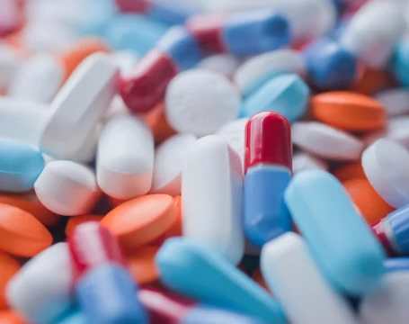
Medicine Recommendation System
Team : 66
Prakhar Awasthi
Akshay Pandey
Pratibimb Swain
Hemant Yadav

Slide 2
Project Objectives
Our project suggests diseases, their descriptions, medicines and precautions for diseases that are predicted based on various symptoms provided by the user.
This is really helpful especially for people who cannot afford doctor appointments
Our system recommends medications that have proven to be more effective for similar patient cases improving treatment outcomes.

Slide 3
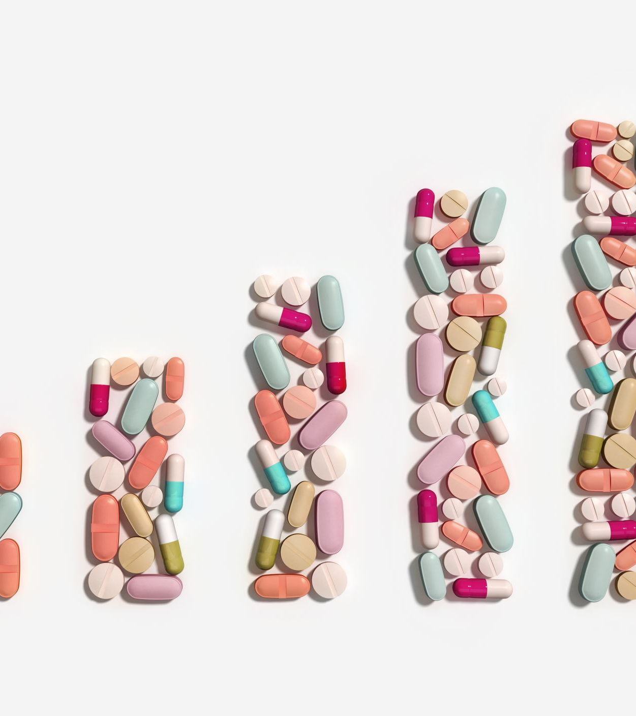
Work done so far ….
Till now we have trained the model on a dataset to input symptoms from the user and predict diseases and the corresponding description of the diseases, their medications and precautions.

Slide 4
Challenges faced
Finding the appropriate Dataset to train the model on.
Started working on new and unfamiliar technologies like OnDemand API and using prompt engineering.
Working with a team and collaborating with everyone
Other external issues such as network

Slide 5

Plans for the remaining time
Designing the front end of the website to be made for the project.
Structuring the back end and integrating the model into the website using OnDemand API.
Hoping our project runs seamlessly through the numerous tests we run through it.

